Slide 1
Debt Letters MVP

Slide 2
Why take on this work?
The History
During the session of the 115th Congress, the Veterans Fair Debt Notice Act of 2018 was passed, establishing a wide-sweeping set of provisions, the most important of which are aimed at better informing Veterans when and why they have incurred a debt with the VA, what their options are to resolve it, and a digital method by which to receive those communications.
Fast forward two years, and nothing has happened. In the last month DEPO was engaged by our partners in the Veterans Experience Office (VEO) with a proposal (XXX) to prioritize a slimmed down set of requirements for development into an MVP.
VEO submitted to us a solution-oriented document that outlines their desired set of requirements and outcomes. DEPO officially accepted this project via the standard intake process and organized Benefits and Memorials Team 2 (BAM2) as the implementation team focuses on delivering an initial MVP that realizes actual value both for the Veteran (clarity, awareness, empathy, accuracy, timeliness) AND for the business (digital, progress).

Slide 3
Letters, Letters, Letters…
Scope of the problem?
Any Veteran-related document that is digitized, ultimately winds up within a document respository (eFolder) which exists for each Veteran and itself resides within the VA’s claims management system, VBMS
Debt letters can be generated by various business lines around the VA (EDU, Compensation, etc), and come in various types (think “New Debt Alert” or “3rd Notice of Deliquency”); the exact number of different types is not clear, but we have heard “probably like 50” O_O…But don’t get scared just yet, because…
Currently, only a small subset of the total # of letter types have been digitized and are being actively sent to Veteran eFolders; this means we can focus on the 5-10 “eFolder-supported” debt letters
That being said, it is extremely unclear at this point how well documented the letter type/name taxonomy is, and even more unclear how consistently it is applied to the actual documents in the eFolders…
But it’s not all bad news! We’ve been told there is an existing integration between vets-api and the Veteran eFolder (https://github.com/department-of-veterans-affairs/lighthouse-bgs); it seems to contain services which may be useful, and at the very least lay the groundwork for new functionality without the need to work through establishing a brand new connection

Slide 4
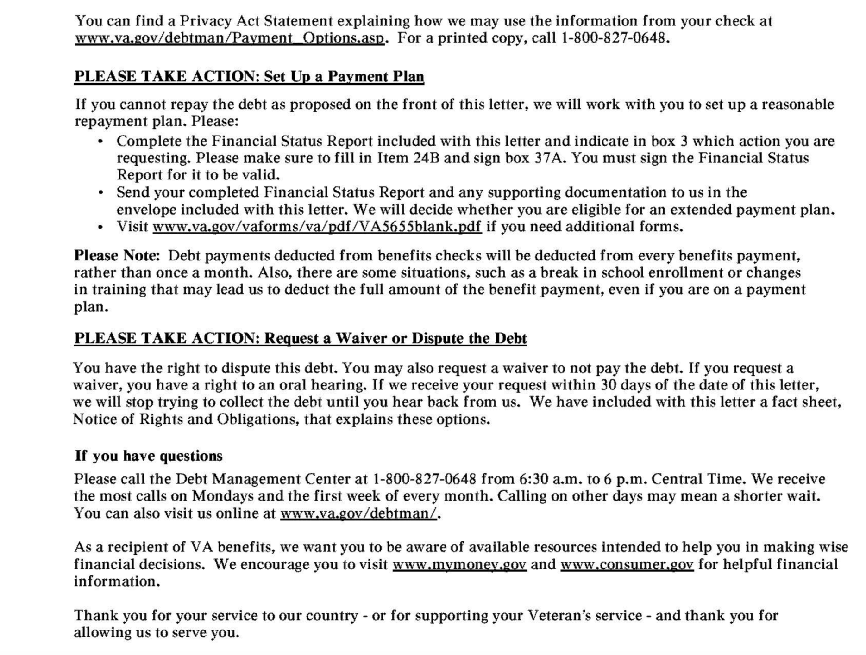
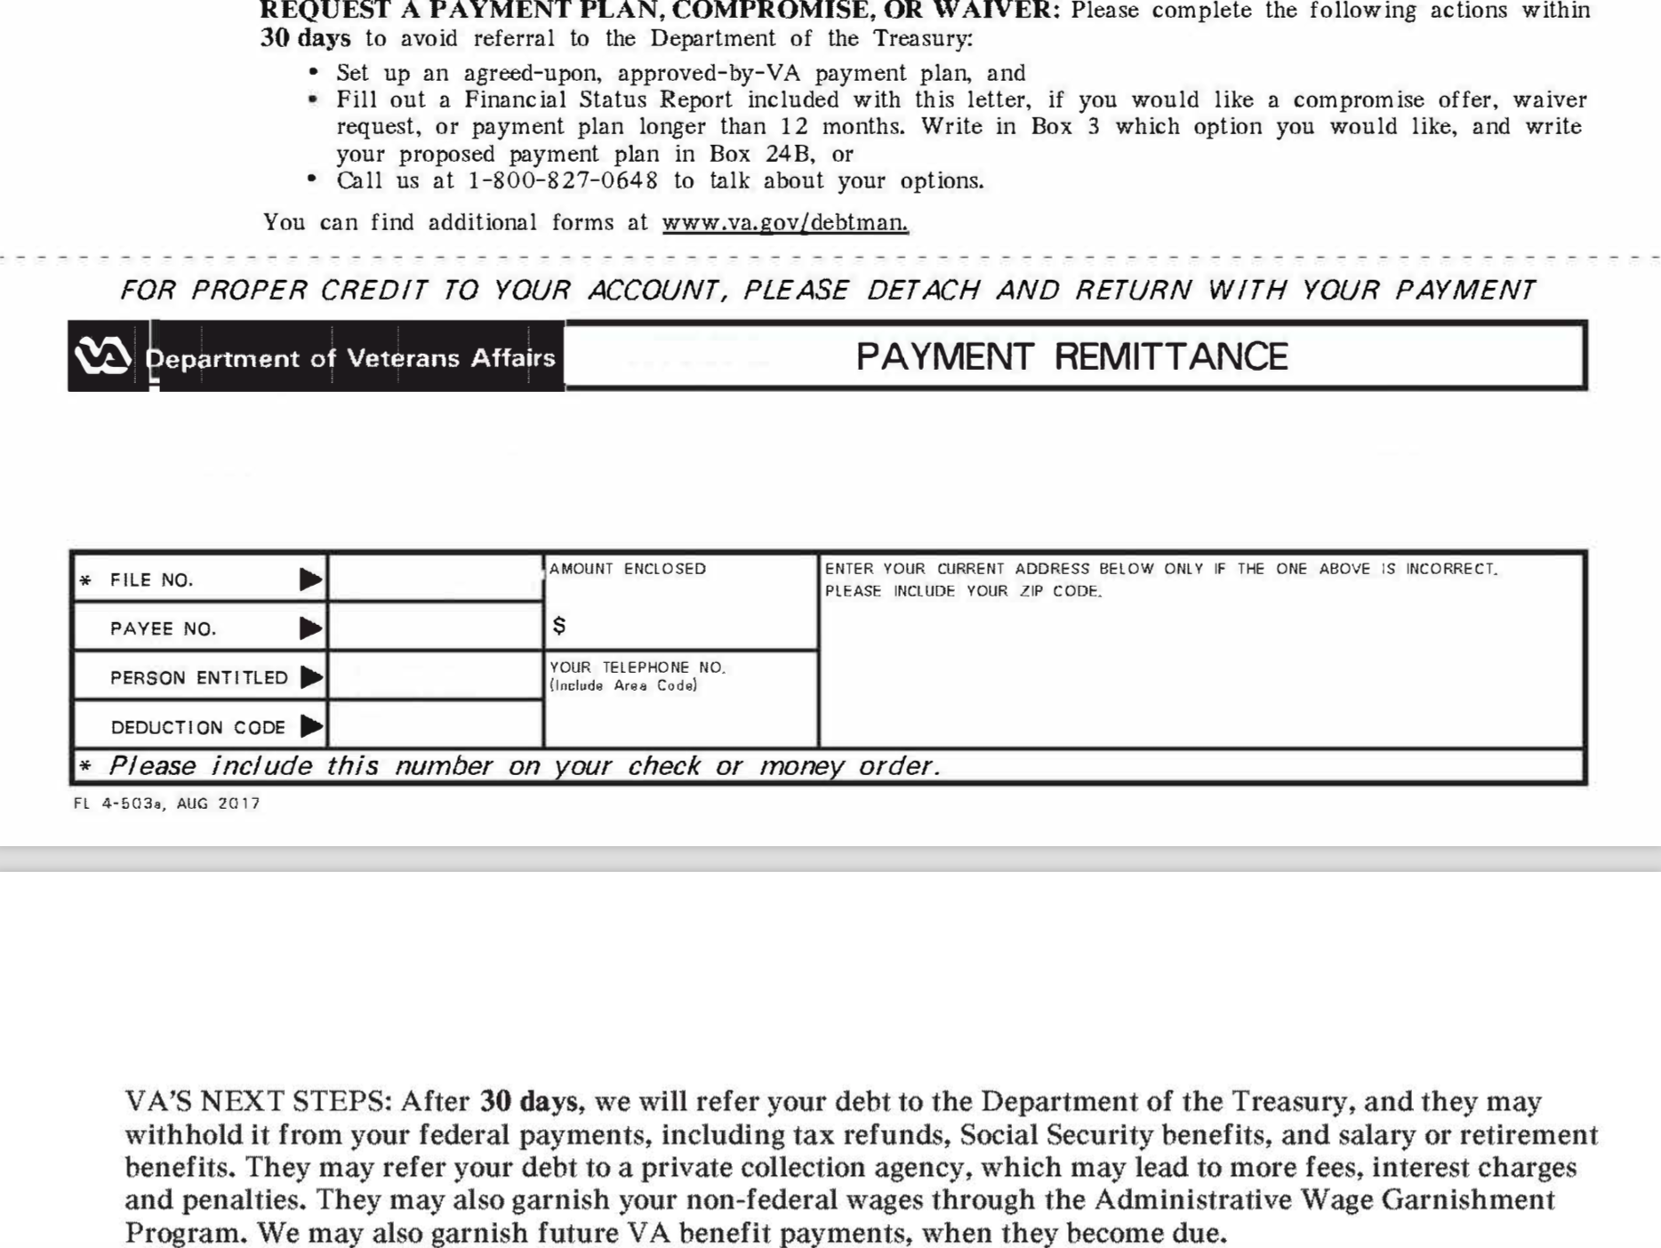
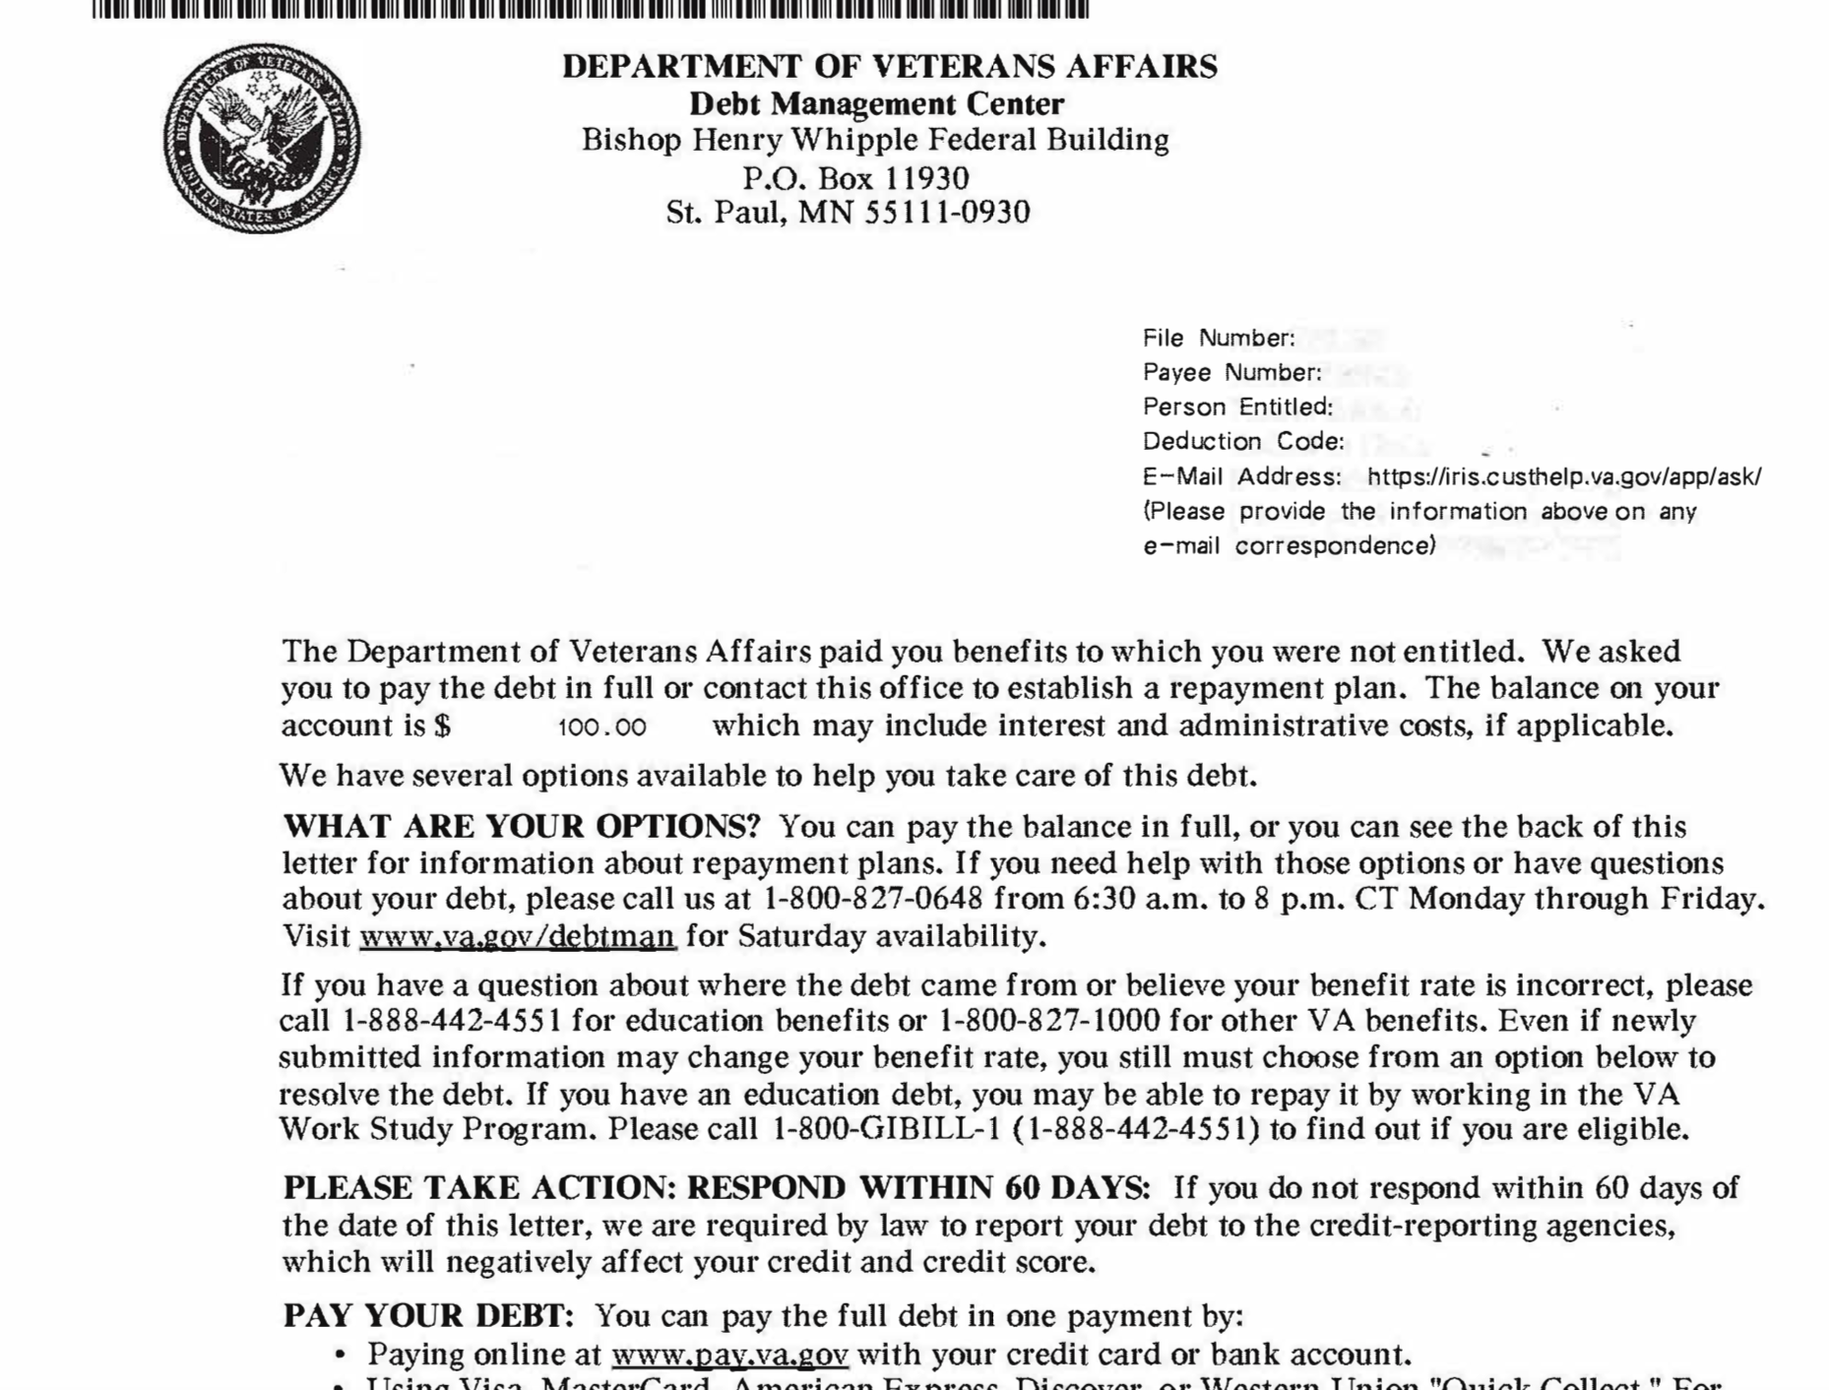
But Wait! Most of it is on PAPER! (~XX%)
Surprise! You owe us money!
We’re docking next month’s disability check :)
Currently, while Veterans can call the VA to manage/adjudicate debt, the only standardized process for communicating information about debt outbound to Veterans, is via printed letters sent through the mail.
Notes:
EE
There were a lot of issues identified, but we had to scope our efforts towards something we (the team) could do within the last 1.5 weeks that would have the most impact.
We collected research observations in Mural, and collected possible opportunities we identified. Then we charted the opportunities on feasibility and impact for CRCL -accesses.
Then we voted on solutions we could provide that we thought were the most impactful
[Note: Explain how we could’ve solved any problem in the Mural, but went through targeted exercises to scope it down and voted.]

Slide 5
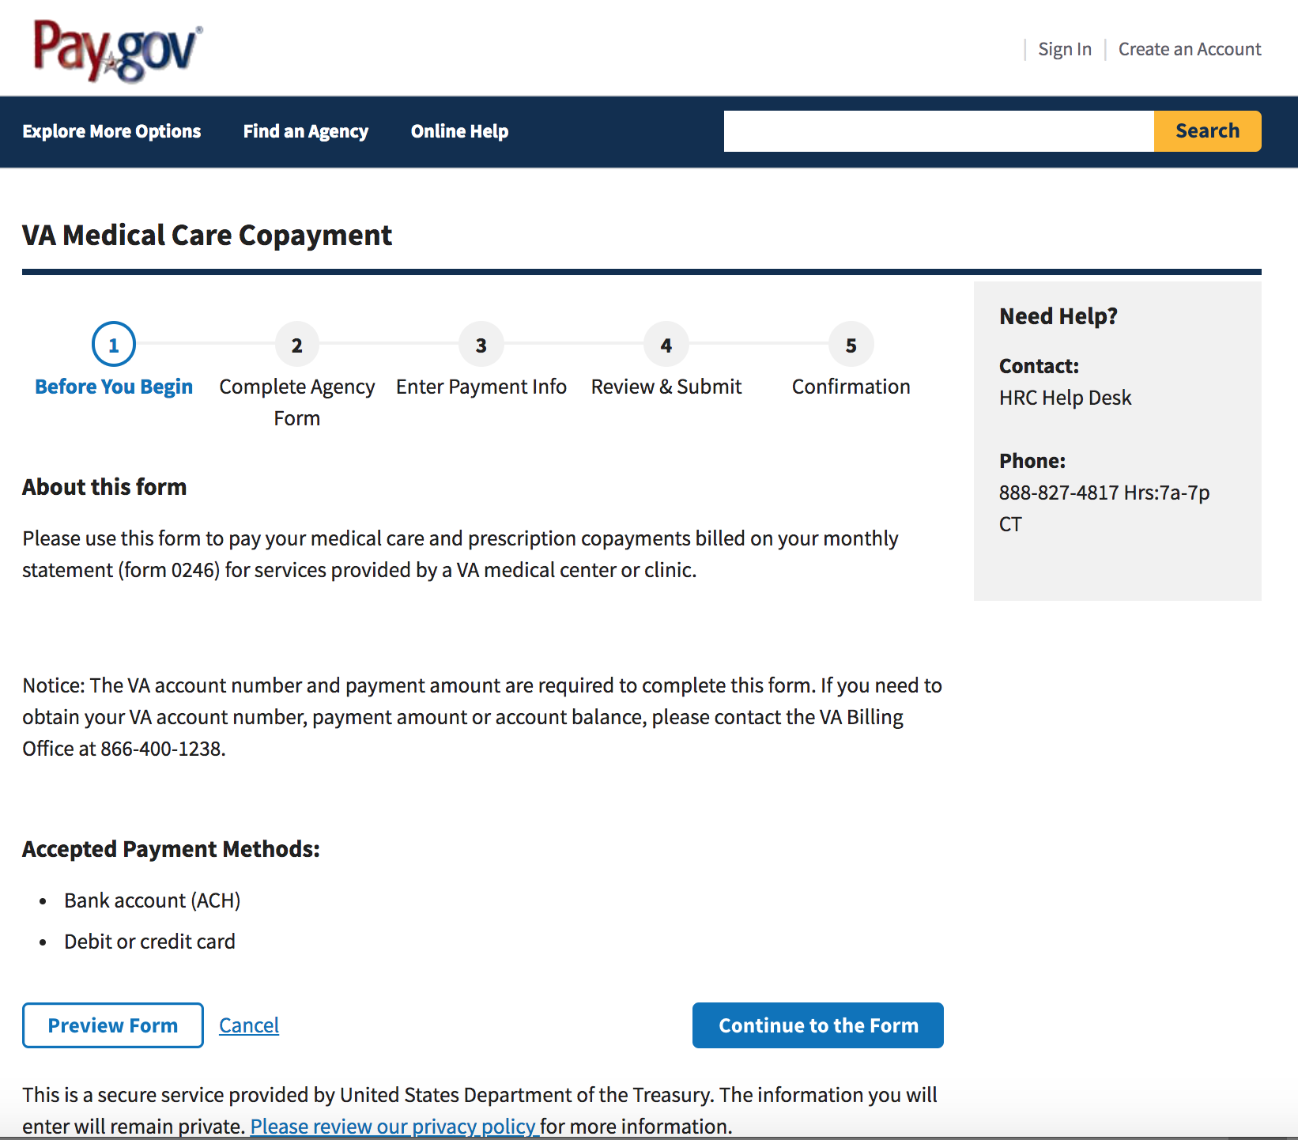
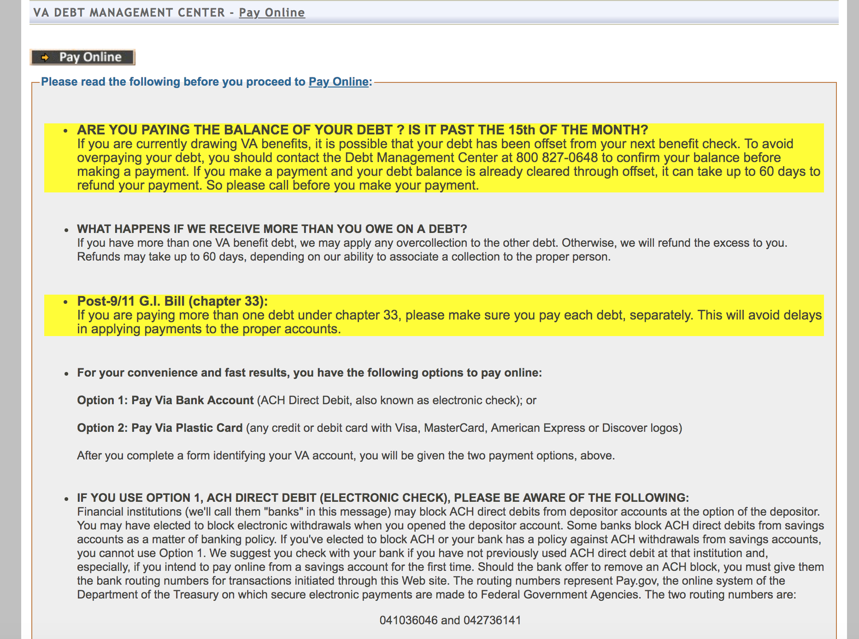
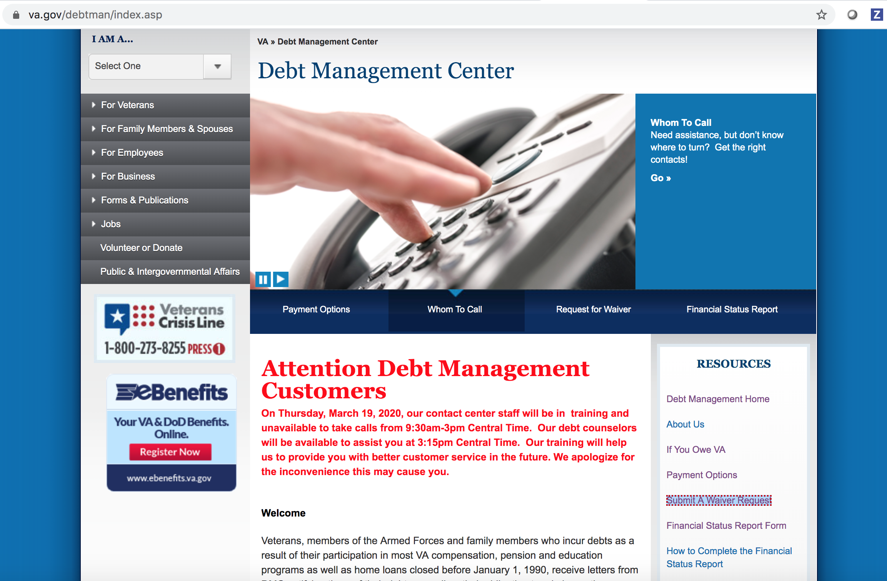
The Digital Experience Today (~XX%)
The digital debt management/resolution process is confusing, disjointed, and aggressive.

Slide 6
Requested Functionality
Solution Ideas?
Online viewing of a defined subset of debt notification letters on VA.gov
Single landing page for the digital management of debt
Automated electronic notification of availablilty of new debt letters of the supported types
New/revised content for supported letter types (digital and paper?)

Slide 7
Help we might need?
Content: Depending on where DMC and the stakeholder group want to go with the existing paper letters, this could be anywhere from average to very very substantial..
Engineering: Technical expertise from VSA/VSP on the existing VBMS and BGS integrations; who built this? Who do we work with to enhance and better document it?

